Slide 1

Cyber Security Project
Credential Harvesting(Phishing)
Student Name: Rishab Verma
Roll Number: 2021UCA1946
Branch: CSAI 2
Instructor : Gaurav Singal Sir

Slide 2
What is Credential Harvesting?
A cyberattack in which cybercriminals are able to gather usernames and passwords using email phishing and other exploits.
Attackers sends links among people so that users will be fooled into entering their username or password.
Attackers can use these sensitive details for their own exploits or they can trade them.

Slide 3

How To Perform an Attack?

Slide 4
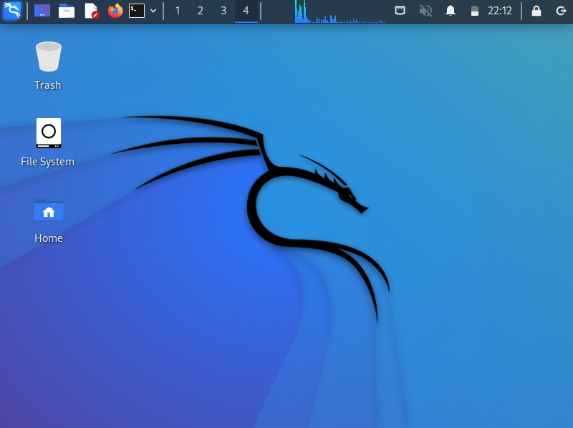
We will be using Kali Linux For performing the attack!!

Slide 5
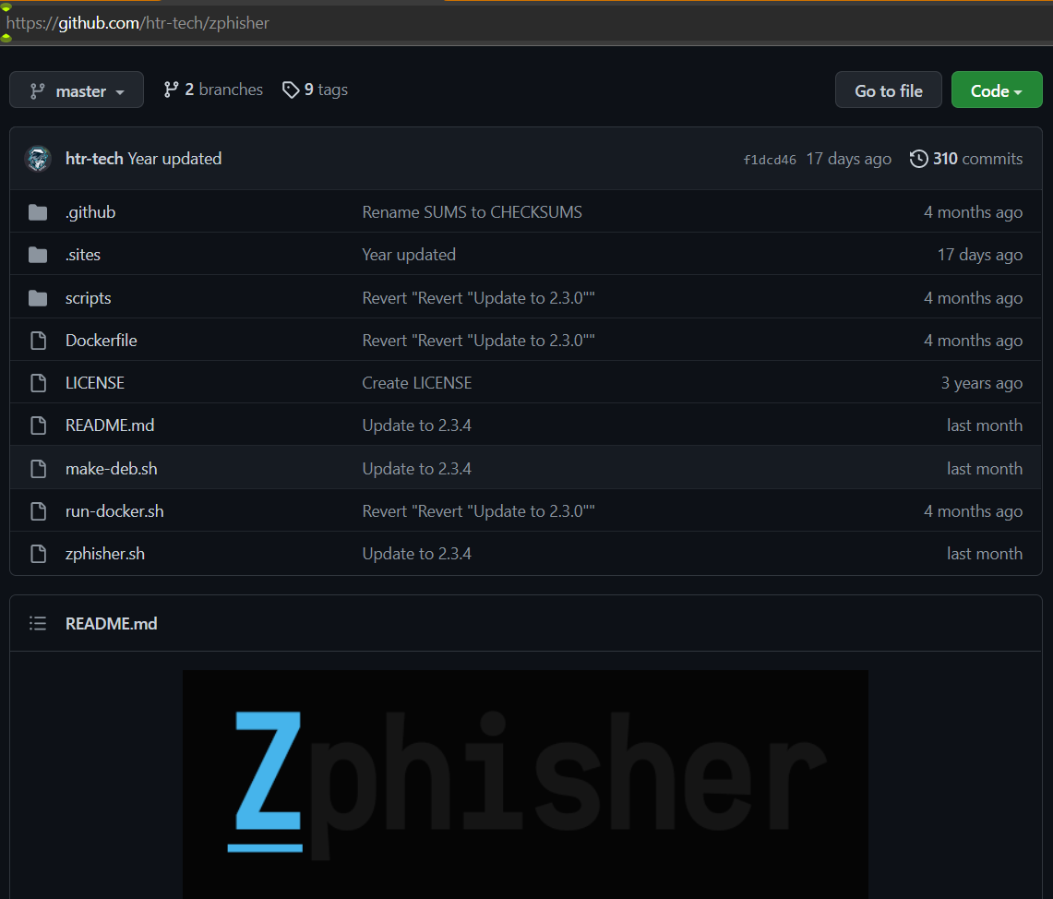
We are going to use an additional tool namely Zphisher.
We will be adding the Zphisher into our kali linux.

Slide 6
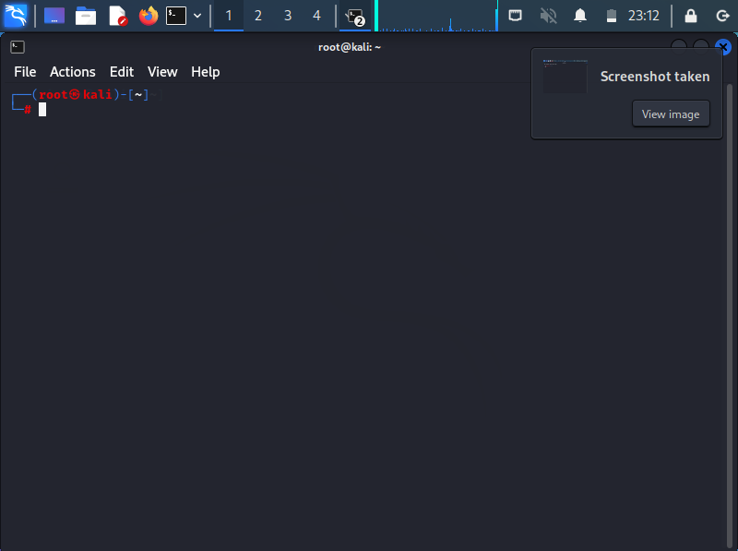
First we’ve to add all the files mentioned in previous slide into our kali linux.
After that we’ve to open the root terminal of linux.

Slide 7
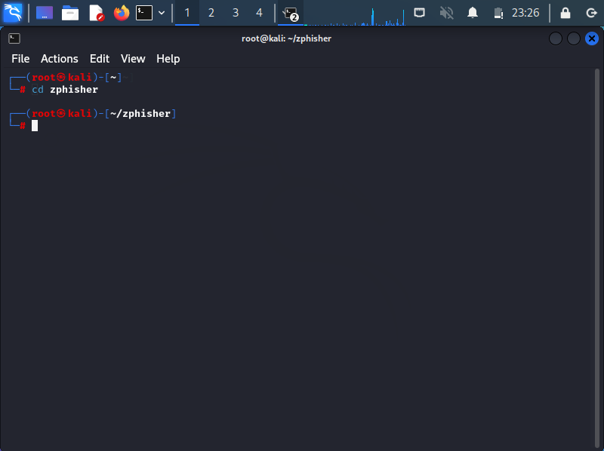
After Opening the terminal we’ve to change the directory of zphisher and make it available into the terminal we are working.
For that we’ll write cd zphisher where cd stands for change directory.
Press Enter.

Slide 8
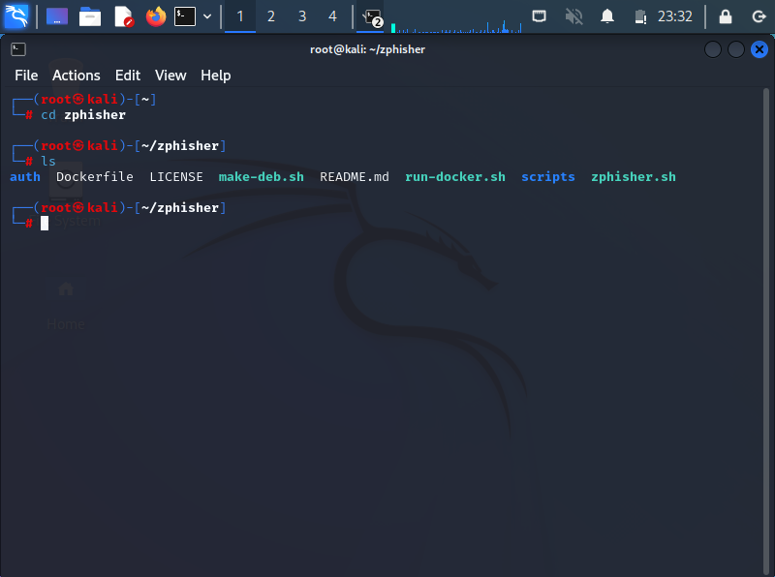
After that we’ve come into the folder of zphisher.
Now to check the contents of folder we’ve to write ls where ls stands for list.
Press Enter.

Slide 9
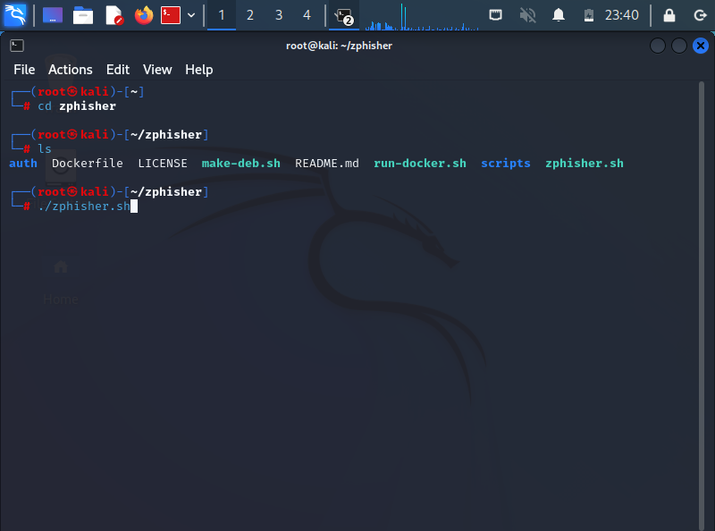
Now to run zphisher we’ll be writing ./zphisher.sh
Press Enter.

Slide 10
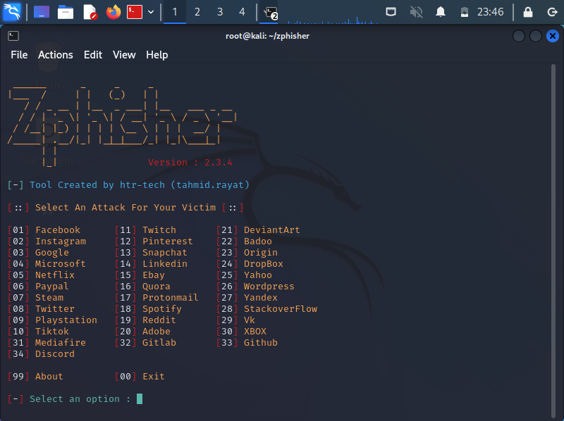
After Entering the Enter key, screen will be having many websites names.
Now we’ve to select the website which we want to make the clone for our attack.

Slide 11
We can select any website mentioned in the options to be cloned.
Let us make a clone of Github.
For that we’ve to select option number of github.
After that for link creation we’ll be using cloudfare option which will be visible after we enter the website number.
After creating the link for testing whether it is working or not we’ve to copy link’s address and then paste it into linux’s firefox.
After that the cloned page will be visible to us asking for username and a password.

Slide 12
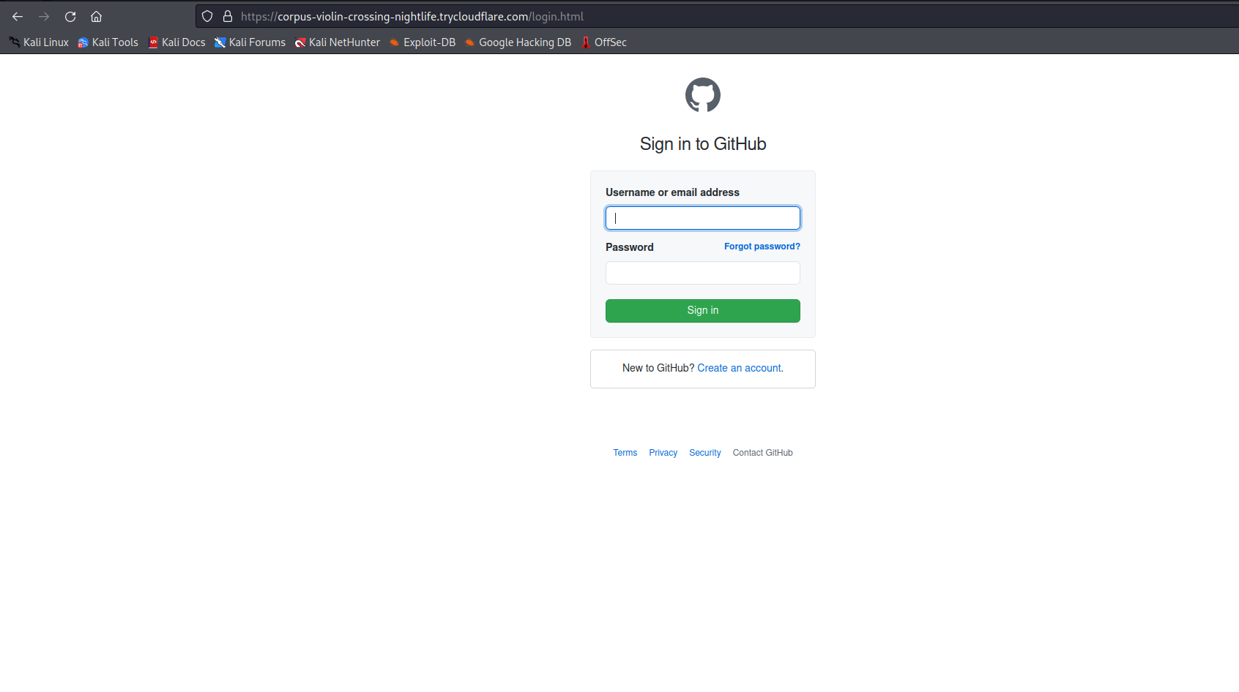

Slide 13
After opening the link the page will be visible as seen in the previous one.
Now as we opened the link our device’s IP address will be shown in the terminal.
Thereafter whatever details we’ll fill also become visible to us in the terminal after sign in key gets pressed.

Slide 14
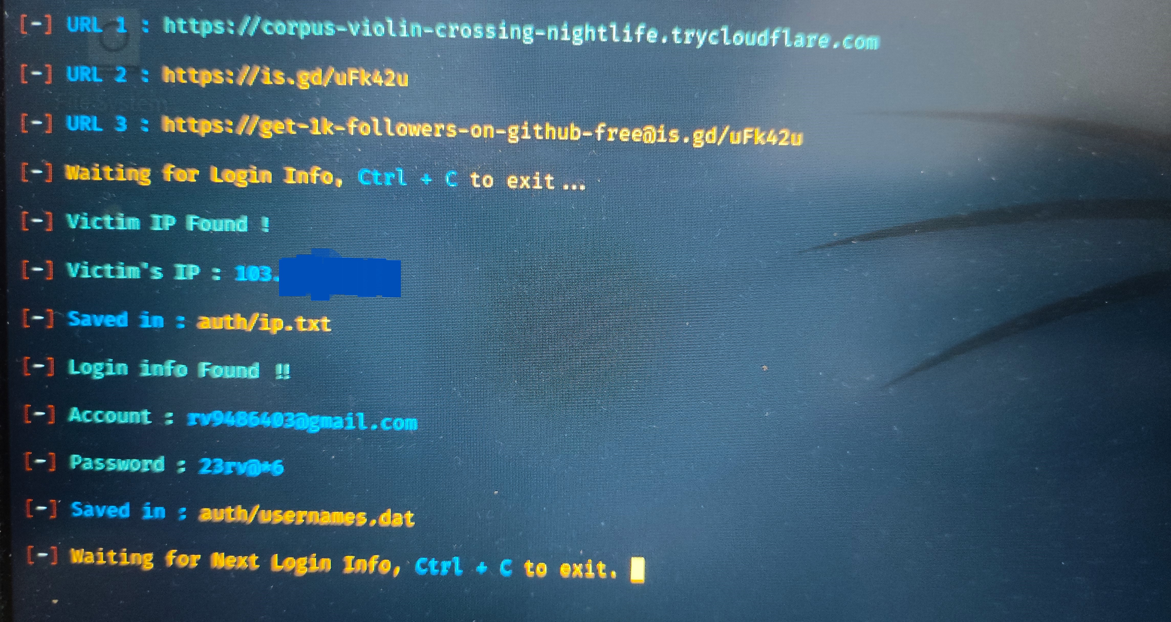

Slide 15
So in this way whoever opens the link , his/her IP address along with the details he/she is filling will be visible to the attacker.
After completion of the attack for terminating the current work we’ve to write ctrl+c .
In this way we can do a credential harvesting attack.

Slide 16
Thank You

